Slide 1



LEXICAL ANALYZER

Slide 2
Lexical Analyzer: Input Buffering
The main task of the lexical analyzer is to read the input characters of the source program group them into lexemes and produce as output a sequence of tokens for each lexeme in the source program.
When the lexical analyzer discovers a lexeme constituting an identifier, it needs to enter that lexeme into the symbol table.
The lexical analyzer not only identifies the lexemes but also pre-processes the source text like removing comments, white spaces, etc.

Slide 3
Roles of the Lexical Analyzer
Lexical analyzer performs below given tasks:
Helps to identify token into the symbol table
Removes white spaces and comments from the source program
Correlates error messages with the source program
Helps you to expands the macros if it is found in the source program
Read input characters from the source program

Slide 4
Lexical Analyzer: Input Buffering
Lexical analyzers are divided into a cascade of two processes:
Scanning: It consists of simple processes that do not require the tokenization of the input such as deletion of comments, compaction of consecutive white space characters into one.
Lexical Analysis: This is the more complex portion where the scanner produces sequence of tokens as output.

Slide 5
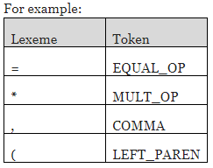
TOKEN
A Token is pair consisting of a token name and an optional attribute value. The token name is an abstract symbol representing the kind of lexical unit.

Slide 6
PATTERN?
A pattern is a description of the form that the lexemes of a token may take. In case of a keyword as a token the pattern is just a sequence of characters that form the keyword.

Slide 7
LEXEME
A Lexeme is a sequence of characters in the source program that matches the pattern for a token and is identified by the lexical analyzer as an instance of that token.

Slide 8
INPUT BUFFERING
To ensure that a right lexeme is found, one or more characters have to be looked up beyond the next lexeme.
Hence a two-buffer scheme is introduced to handle large lookaheads safely.
Techniques for speeding up the process of lexical analyzer such as the use of sentinels to mark the buffer end have been adopted.

Slide 9
Approaches for the implementation of the Lexical Analyzer
There are three general approaches for the implementation of a lexical analyzer: 1. By using a lexical-analyzer generator: In this, the generator provides routines for reading and buffering the input.
2. By writing the lexical analyzer in a conventional systems-programming language, using I/O facilities of that language to read the input.
3. By writing the lexical analyzer in assembly language and explicitly managing the reading of input.

Slide 10
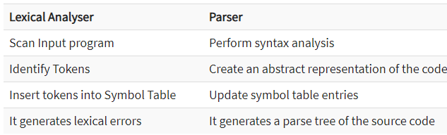
Lexical Analyzer VS. Parser

Slide 11
Why Lexical Analyzer and Parser
The simplicity of design: It eases the process of lexical analysis and the syntax analysis by eliminating unwanted tokens
To improve compiler efficiency: Helps you to improve compiler efficiency
Specialization: specialized techniques can be applied to improves the lexical analysis process
Portability: only the scanner requires to communicate with the outside world
Higher portability: input-device-specific peculiarities restricted to the lexer

Slide 12
Advantages of Lexical Analyzer
Lexical analyzer method is used by programs like compilers which can use the parsed data from a programmer's code to create a compiled binary executable code
It is used by web browsers to format and display a web page with the help of parsed data from JavsScript, HTML, CSS
A separate lexical analyzer helps you to construct a specialized and potentially more efficient processor for the task

Slide 13
Disadvantages of Lexical Analyzer
You need to spend significant time reading the source program and partitioning it in the form of tokens
Some regular expressions are quite difficult to understand compared to PEG or EBNF rules
More effort is needed to develop and debug the lexer and its token descriptions
Additional runtime overhead is required to generate the lexer tables and construct the tokens

Slide 14
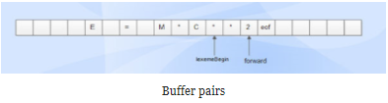
What is Buffer Pairs
A specialized buffering techniques0 used to reduce the amount of overhead, which is required to process an input character in moving characters.

Slide 15
What is Buffer Pairs
Consists of two buffers, each consists of N-character size which are reloaded alternatively.
Two pointers lexemeBegin and forward are maintained.
Lexeme Begin points to the beginning of the current lexeme which is yet to be found.
Forward scans ahead until a match for a pattern is found.
Once a lexeme is found, lexeme begin is set to the character immediately after the lexeme which is just found and forward is set to the character at its right end.
Current lexeme is the set of characters between two pointers.

Slide 16
Sentinels
Sentinels is used to make a check, each time when the forward pointer is moved, a check is done to ensure that one half of the buffer has not moved off. If it is done, then the other half must be reloaded.
Therefore the ends of the buffer halves require two tests for each advance of the forward pointer.
Test 1: For end of buffer.
Test 2: To determine what character is read.
The usage of sentinel reduces the two tests to one by extending each buffer half to hold a sentinel character at the end.
The sentinel is a special character that cannot be part of the source program. (eof character is used as sentinel).

Slide 17
Sentinels
Disadvantages:
This scheme works well most of the time, but the amount of lookahead is limited.
This limited lookahead may make it impossible to recognize tokens in situations where the distance that the forward pointer must travel is more than the length of the buffer.

Slide 18
Sentinels
Advantages:
Most of the time, It performs only one test to see whether forward pointer points to an eof.
Only when it reaches the end of the buffer half or eof, it performs more tests.
Since N input characters are encountered between eofs, the average number of tests per input character is very close to 1.

Slide 19
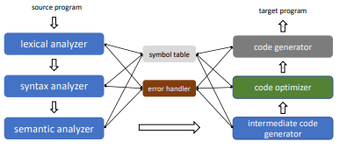
An Overview of Compilation

Slide 20

Overview of Lexical Analysis
First stage of a three-part frontend to help understand the source program
• Processes every character in the input program
• If a word is valid, then it is assigned to a syntactic category
• This is similar to identifying the part of speech of an English word

Slide 21
Description of Lexical Analysis
Input:
• A high level language program, such as a C or Java program, in the form of a sequence of ASCII characters
Output:
• A sequence of tokens along with attributes corresponding to different syntactic categories that is forwarded to the parser for syntax analysis

Slide 22
Description of Lexical Analysis
Functionality:
• Strips off blanks, tabs, newlines, and comments from the source program
• Keeps track of line numbers and associates error messages from various parts of a compiler with line numbers
• Performs some preprocessor functions in languages like C

Slide 23
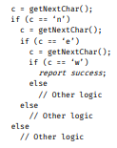

Recognizing Word “new”

Slide 24
TOKENS
Token
• A string of characters which logically belong together in a syntactic category
• Sentences consist of a string of tokens
• For example, float, identifier, equal, minus, intnum, semicolon • Tokens are treated as terminal symbols of the grammar specifying the source language
• May have an optional attribute

Slide 25
PATTERNS AND LEXEMES
Pattern
• The rule describing the set of strings for which the same token is produced
• The pattern is said to match each string in the set
• float, letter(letter|digit|_)*, =, -, digit+ , ;
Lexeme
• The sequence of characters matched by a pattern to form the corresponding token
• “float”, “abs_zero”, “=”, “-”, “273”, “;”

Slide 26
TOKENS IN PROGRAMMING LANGUAGES
• Keywords, operators, identifiers (names), constants, literal strings, punctuation symbols (parentheses, brackets, commas, semicolons, and colons)
• Attributes for tokens (apart from the integer representing the token)
• identifier: the lexeme of the token, or a pointer into the symbol table where the lexeme is stored by the LA
• intnum: the value of the integer (similarly for floatnum, etc.)
• string: the string itself
• The exact set of attributes are dependent on the compiler designer

Slide 27
ROLE OF A LEXICAL ANALYZER
• Identify tokens and corresponding lexemes
• Construct constants: for example, convert a number to token num and pass the value as its attribute
• 31 becomes <num, 31>
• Recognize keyword and identifiers
• counter = counter + increment becomes id = id + id
• Check that id here is not a keyword
• Discard whatever does not contribute to parsing
• White spaces (blanks, tabs, newlines) and comments

Slide 28
Specifying and Recognizing Patterns and Token
• Patterns are denoted with regular expressions, and recognized with finite state automata
• Regular definitions, a mechanism based on regular expressions, are popular for specification of tokens
• Transition diagrams, a variant of finite state automata, are used to implement regular definitions and to recognize tokens
• Usually used to model LA before translating them to executable programs

Slide 29
Transition Diagrams
• Transition diagrams (TDs) are generalized DFAs with the following differences
• Edges may be labelled by a symbol, a set of symbols, or a regular definition
• Few accepting states may be indicated as retracting states
• Indicates that the lexeme does not include the symbol that transitions to the accepting state
• Each accepting state has an action attached to it
• Action is executed when the state is reached
• Typically, such an action returns a token and its attribute value

Slide 30

Examples of Transition Diagrams
• * indicates a retraction state
• get_token_code() searches a table to check if the name is a reserved word and returns its integer code if so
• Otherwise, it returns the integer code of the IDENTIFIER token, with name containing the string of characters forming the token
• Name is not relevant for reserved words

Slide 31
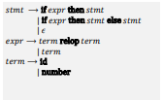
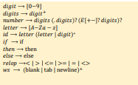
A Sample Specification

Slide 32
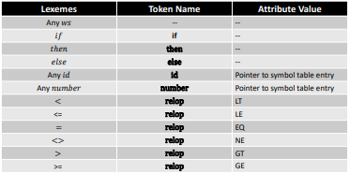
Tokens, Lexemes, and Attributes

Slide 33
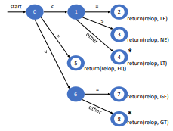
Transition Diagram for relop

Slide 34
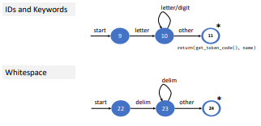
Transition Diagrams for IDs and Keywords

Slide 35
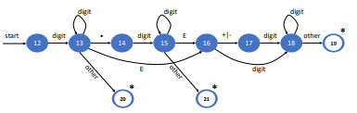
Transition Diagram for Unsigned Numbers

Slide 36
Combining Transition diagrams to form a Lexical Analyzer
• Different transition diagrams (TDs) must be combined appropriately to yield a scanner
• Try different transition diagrams one after another
• For example, TDs for reserved words, constants, identifiers, and operators could be tried in that order
• However, this does not use the “longest match” characteristic
• thenext would be an identifier, and not reserved word then followed by identifier ext
• To find the longest match, all TDs must be tried and the longest match must be used

Slide 37
Challenges in Lexical Analysis
• Certain languages like PL/I do not have any reserved words
• while, do, if, and else are reserved in C but not in PL/I
• Makes it difficult for the scanner to distinguish between keywords and user-defined identifiers
if then then then = else else else = then
if if then then = then + 1

Slide 38
Challenges in Lexical Analysis
• Certain languages like PL/I do not have any reserved words
• while, do, if, and else are reserved in C but not in PL/I
• Makes it difficult for the scanner to distinguish between keywords and user-defined identifiers
• PL/I declarations
• DECLARE(arg1,arg2,arg3,…,argn)
• Cannot tell whether DECLARE is a keyword with variable definitions or is a procedure with arguments until after “)”
• Requires arbitrary lookahead and very large buffers
• Worse, the buffers may have to be reloaded in case of wrong inferences

Slide 39
Challenges in Lexical Analysis
• Is fi a typo or a function call?
• Remember, fi is a valid lexeme for IDENTIFIER
• Think C++
• Template syntax: Foo
• Stream syntax: cin >> var;
• Nested templates: Foo<Bar>

Slide 40
Why separate tokens and lexemes?
• Rules to govern the lexical structure of a programming language is called its microsyntax
• Separating syntax and microsyntax allows for a simpler parser
• Parser only needs to deal with syntactic categories like IDENTIFIER

Slide 41
Error Handling in Lexical Analysis
• LA cannot catch any other errors except for simple errors such as illegal symbols
• In such cases, LA skips characters in the input until a well-formed token is found
• This is called “panic mode” recovery
• We can think of other possible recovery strategies
• Delete one character from the remaining input, or insert a missing character
• Replace a character, or transpose two adjacent characters
• Idea is to see if a single (or few) transformation(s) can repair the error

Slide 42
Thank You

